Slide 1
Strategic Thinking and Coordination
Instructor: Dr. Tanya Rosenblat
Discussion Leader: Linfeng Li & Chen Wang

Slide 2

Visiting Scholar
Tanya Rosenblat
Associate Professor of Information, School of Information
Associate Professor of Economics, College of Literature, Science, and the Arts
University of Michigan
Main research interest: Experimental economics
Recent research: Using experimental methods to explore the effects of physical attractiveness in the labor market, trust in societies and social learning

Slide 3
Learning Goals
Being able to represent strategic situations as games
Identify strategies
Strategy profiles and payoffs
Identify common classes of games (Cooperation, Coordination, Zero-sum)
Solve games using iterated deletion of strictly dominated strategies
Solve games using Nash Equilibrium
Become aware of Nash existence theorem

Slide 4
Author Overview
Linfeng & Chen
10 min

Slide 5
Networks, Crowds, and Markets
David Easley
Jon Kleinberg
Dept. of Information Science,
Cornell University
Dept. of Computer Science,
Cornell University
Economics of information; learning from endogenous data; market microstructure; evolution in games and markets
Algorithms that exploit the combinatorial structure of networks and information

Slide 6
Networks, Crowds, and Markets: Reasoning About a Highly Connected World

Slide 7

Behavioral Game Theory: Experiments in Strategic Interaction
Colin F. Camerer
Division of the Humanities and Social Sciences
Caltech
Risky Choice; Behavioral Game Theory; Limited Strategic Thinking; Patience; Stock Market bubbles; Neuroscience of Economic Decisions

Slide 8
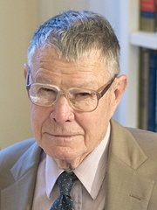
Bargaining, Communication, and Limited War
Thomas C. Schelling
Department of Economics
University of Maryland
He was awarded the Nobel Prize in Economics in 2005, for
“having enhanced our understanding of
conflict and cooperation
through game-theory analysis”

Slide 9
Some other Nobel Prize Winners in Game Theory
Jean Tirole 2014
Alvin E. Roth 2012
Lloyd S. Shapley 2012
Roger B. Myerson 2007
Leonid Hurwicz 2007
Eric S. Maskin 2007
Robert J. Aumann 2005
William Vickrey 1996
James A. Mirrlees 1996
John C. Harsanyi 1994
…

Slide 10
A Short Game About Game Theory
Guess the number
Tanya(Linfeng & Chen)

Slide 11
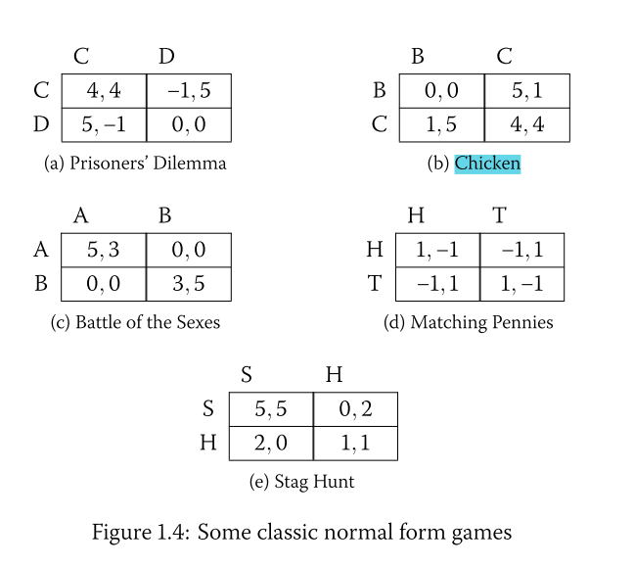
Some Important Games
1. Zero-Sum Games
2. Battle of the Sexes (a coordination game)
3. Chicken or Hawk versus Dove (an anti-coordination game)
4. Prisoner’s Dilemma (a cooperation game)

Slide 12
Networks, Crowds, and Markets
Iterated Deletion
Tanya
40 min

Slide 13
Break
10 min

Slide 14
Networks, Crowds, and Markets
Nash Equilibrium
Tanya
20 min

Slide 15
Tacit Coordination Game
7 Equilibria
Tanya
20 min

Slide 16
Behavioral Game Theory
Tanya
20 min

Slide 17
Bargaining, Communication, and Limited War
Linfeng & Chen
10 min

Slide 18
Open Question
Linfeng & Chen
10 min

Slide 19
Reflection
Linfeng & Chen
10 min

